Slide 1
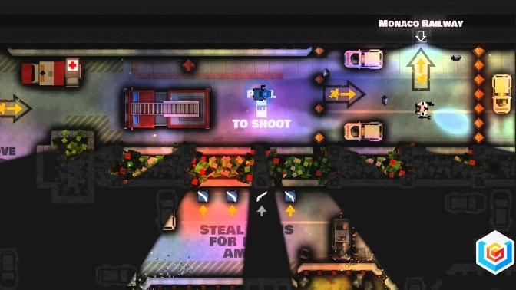
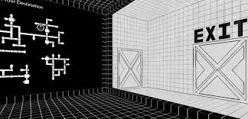
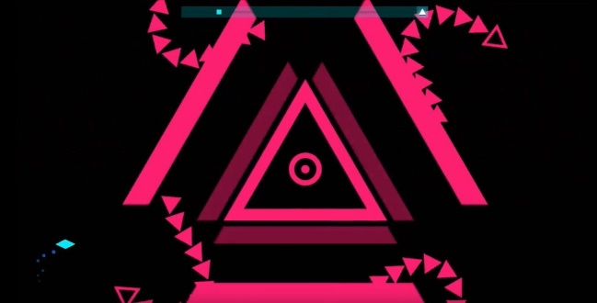
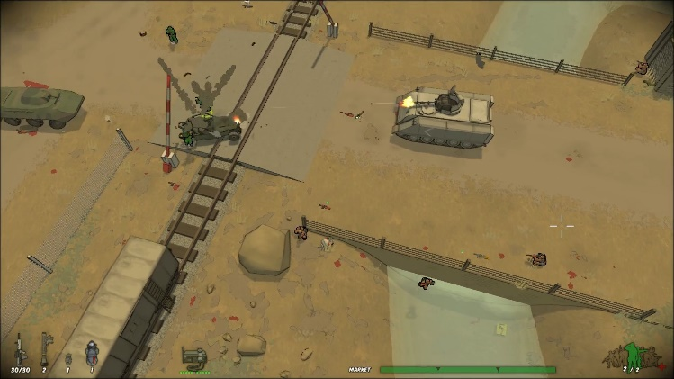
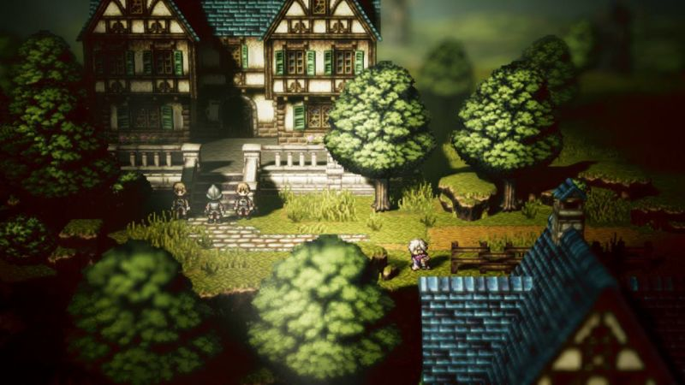
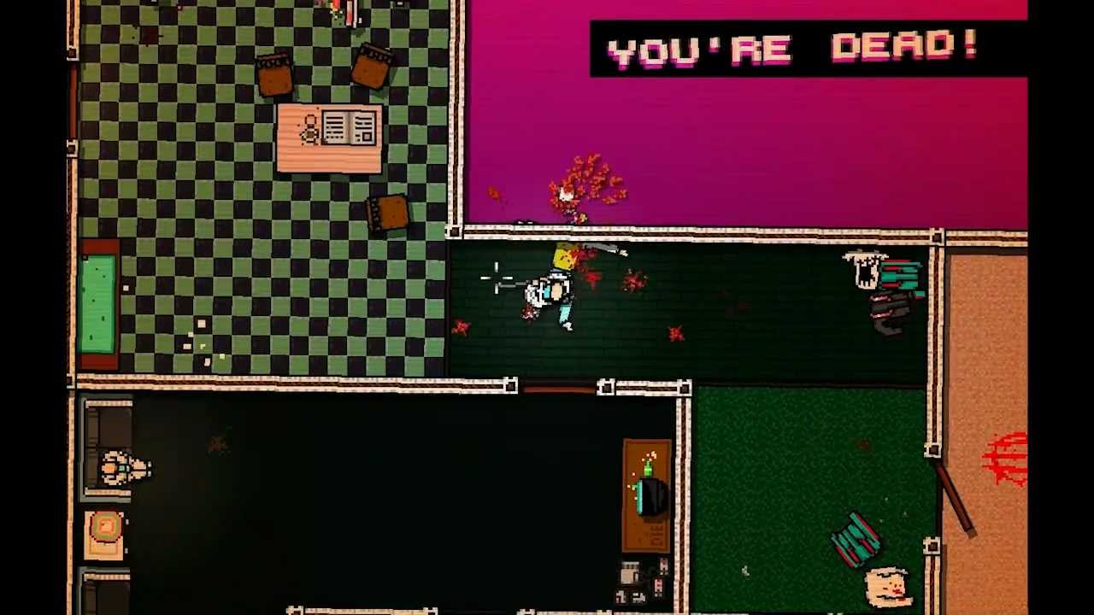
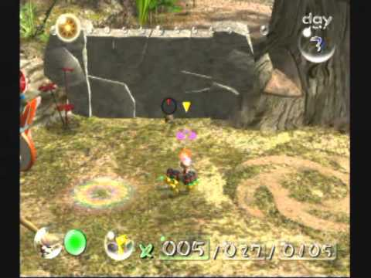
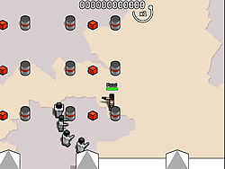
More harsh colours that allow things to stand out easily, important for this so that players to differentiate bullets from the background
Colours stand out, important for game concept. Although this might be too simple
Less realistic cartoony art style: easy to create
Harsh colour differences would make it easy to differentiate projectiles and background
Cartoon/realistic hybrid, harder to create and differentiate foreground and background but nicer to look at then harsh abstract styles
High quality pixel art based, difficult to perfect and can be had to make bullets and projectiles clear from the background. If done well really visually pleasing
More standard pixel art, easy to produce, below average visual quality, can be hard to make the foreground and background differences clear
Cartoony art style, relatively easy to create but difficult to use effectively
Semi-realistic art style, too hard to produce, obvious problems with foreground background differentiation. Unusable for this game concept.
Game will have to be seen from a birds eye view top down rather than an angled top down view so projectiles paths can be seen easily

